Slide 1

Results of the recent eBPM measurements with electron and proton beams
E. Senes, F.G. Guillot-Vignot, M. Krupa, L. Soby, M. Wendt
AWAKE instrumentation meeting
12 December 2018

Slide 2
Outline
Present setup
The ideal case
Beam spectrum for AWAKE gaussian beams
Ideal stripline pickup
The real world
Proton beam
Electron beam
Electron and proton beam
Conclusions and what comes next

Slide 3
Present setup
The electron BPM system installed at AWAKE was developed at TRIUMF and used at CERN for the operation
12 eBPM installed in the beamline
7 eBPM in the electron beamline
5 eBPM in the common beamline
BPM51 was tested. It is the last upstream the plasma cell

Slide 4
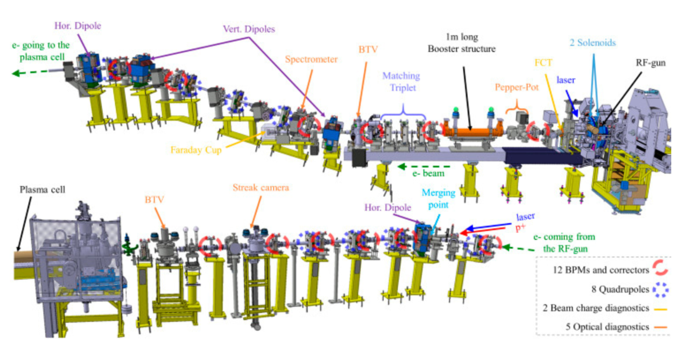
Present setup
S. Liu et al., The installation and commissioning of the AWAKE stripline BPM, Conf. Proc. of IBIC 2018
BPM51

Slide 5
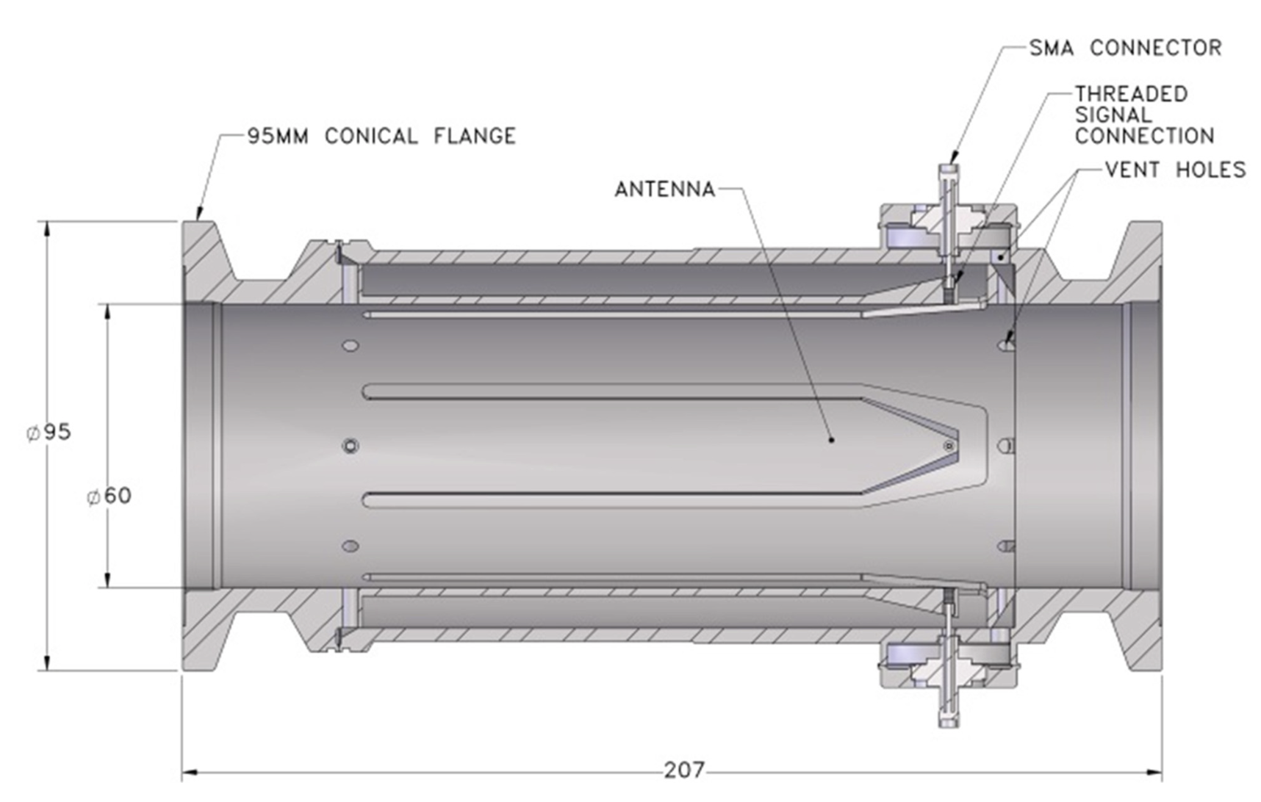
AWAKE eBPM design
S. Liu et al., Development of the AWAKE Stripline BPM
Electronics, Conf. Proc. of TIPP2017

Slide 6
The ideal world

Slide 7
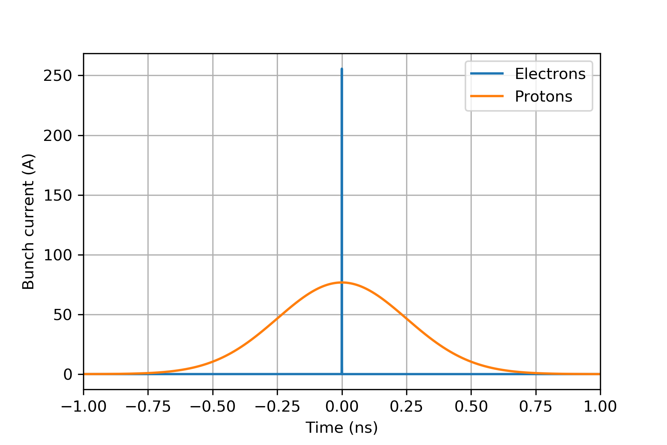
Example p⁺ and e⁻ beams
Electron drive bunch:
1e9 electrons (~160 pC)
1 ps bunch length (4σ)
Proton drive bunch:
3e11 ppb
1 ns bunch length (4σ)

Slide 8
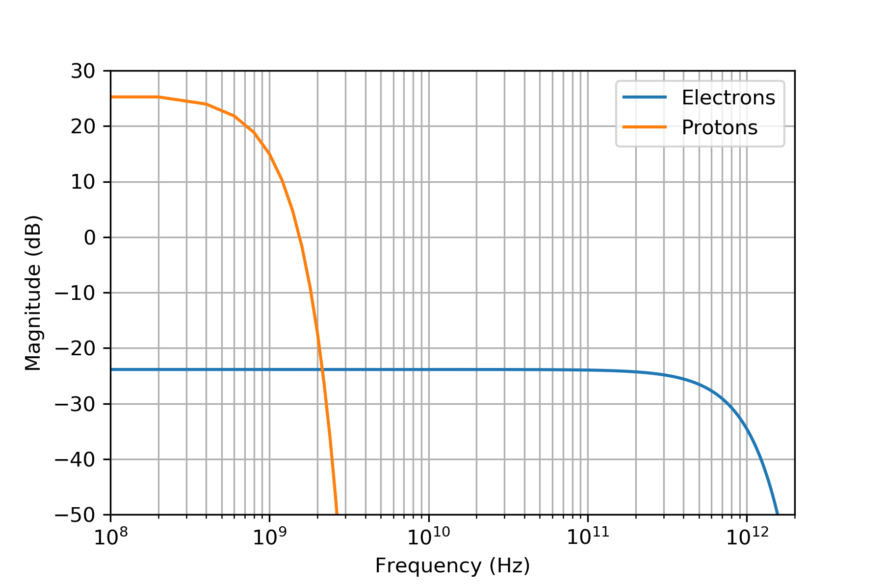
Example p⁺ and e⁻ beams
Same magnitude
at ~2 GHz

Slide 9
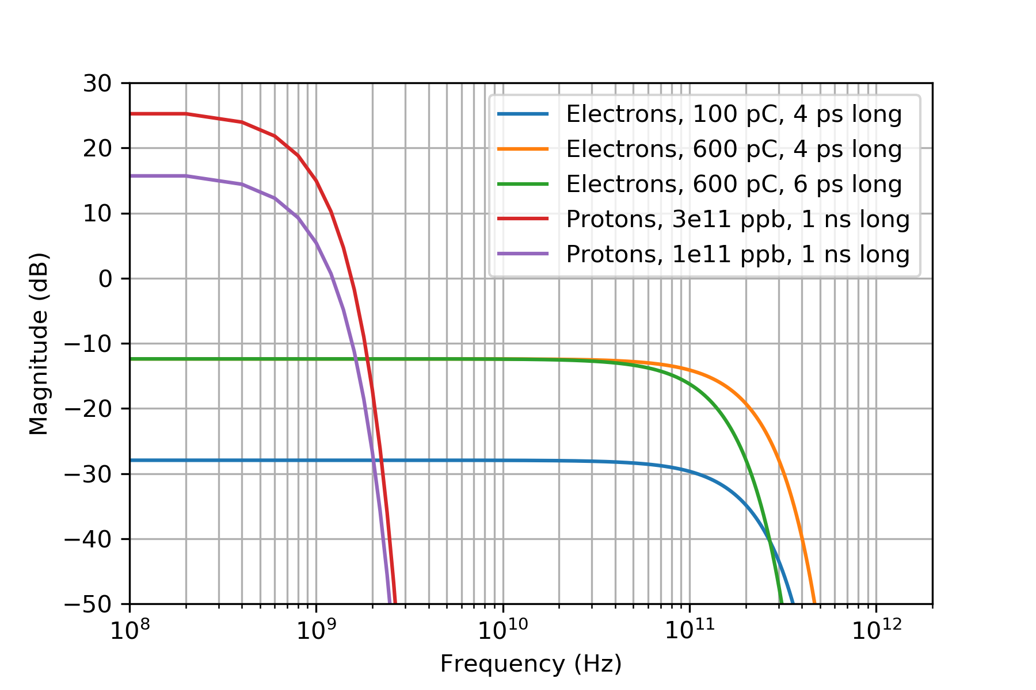
Sensibility to beam parameters
The maximum magnitude depends on the bunch charge
ΔI
Cutoff frequency on the bunch length
Δf_{c}

Slide 10
Sensibility to beam parametres
Using more realistic parameters:
The proton spectrum drops considerably after 1 GHz
The electron spectrum stays almost constant for tens of GHz
Ideal beams assumption
Large dependence on the beam parameters

Slide 11
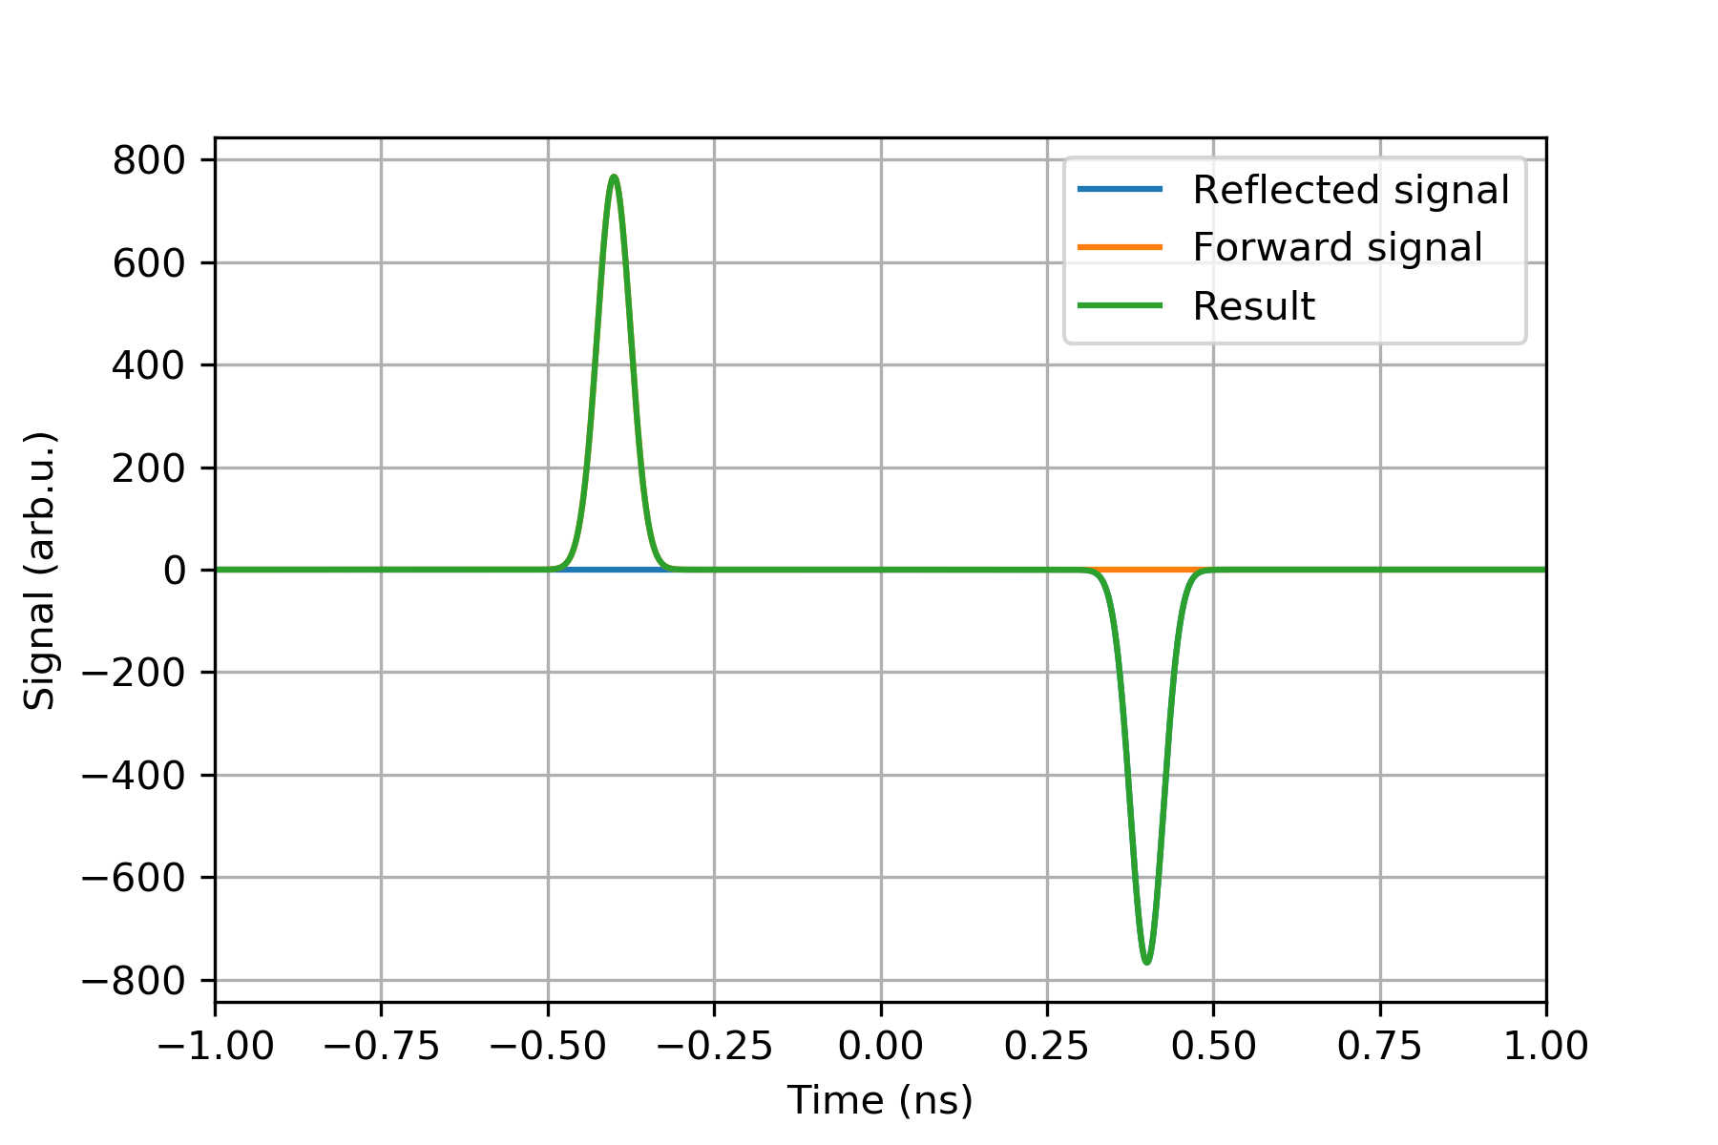
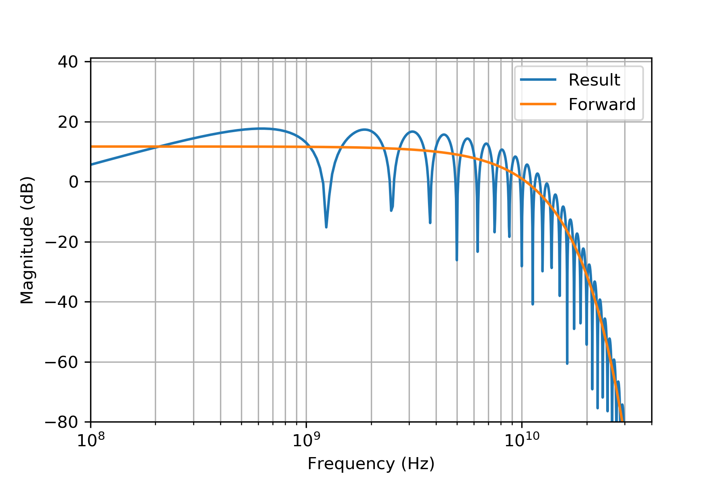
Ideal stripline pickup response
When the bunch overcomes and runs away from the pickup, the reflected signal builds up
The distance between the two peaks is 2L_{stripline}/c. In our case it is ~800 ps for 120 mm electrodes
In frequency domain the ideal beam response is convoluted with the ideal pickup response
Notes:
Say that at HF the freq response is not going to be so nice

Slide 12
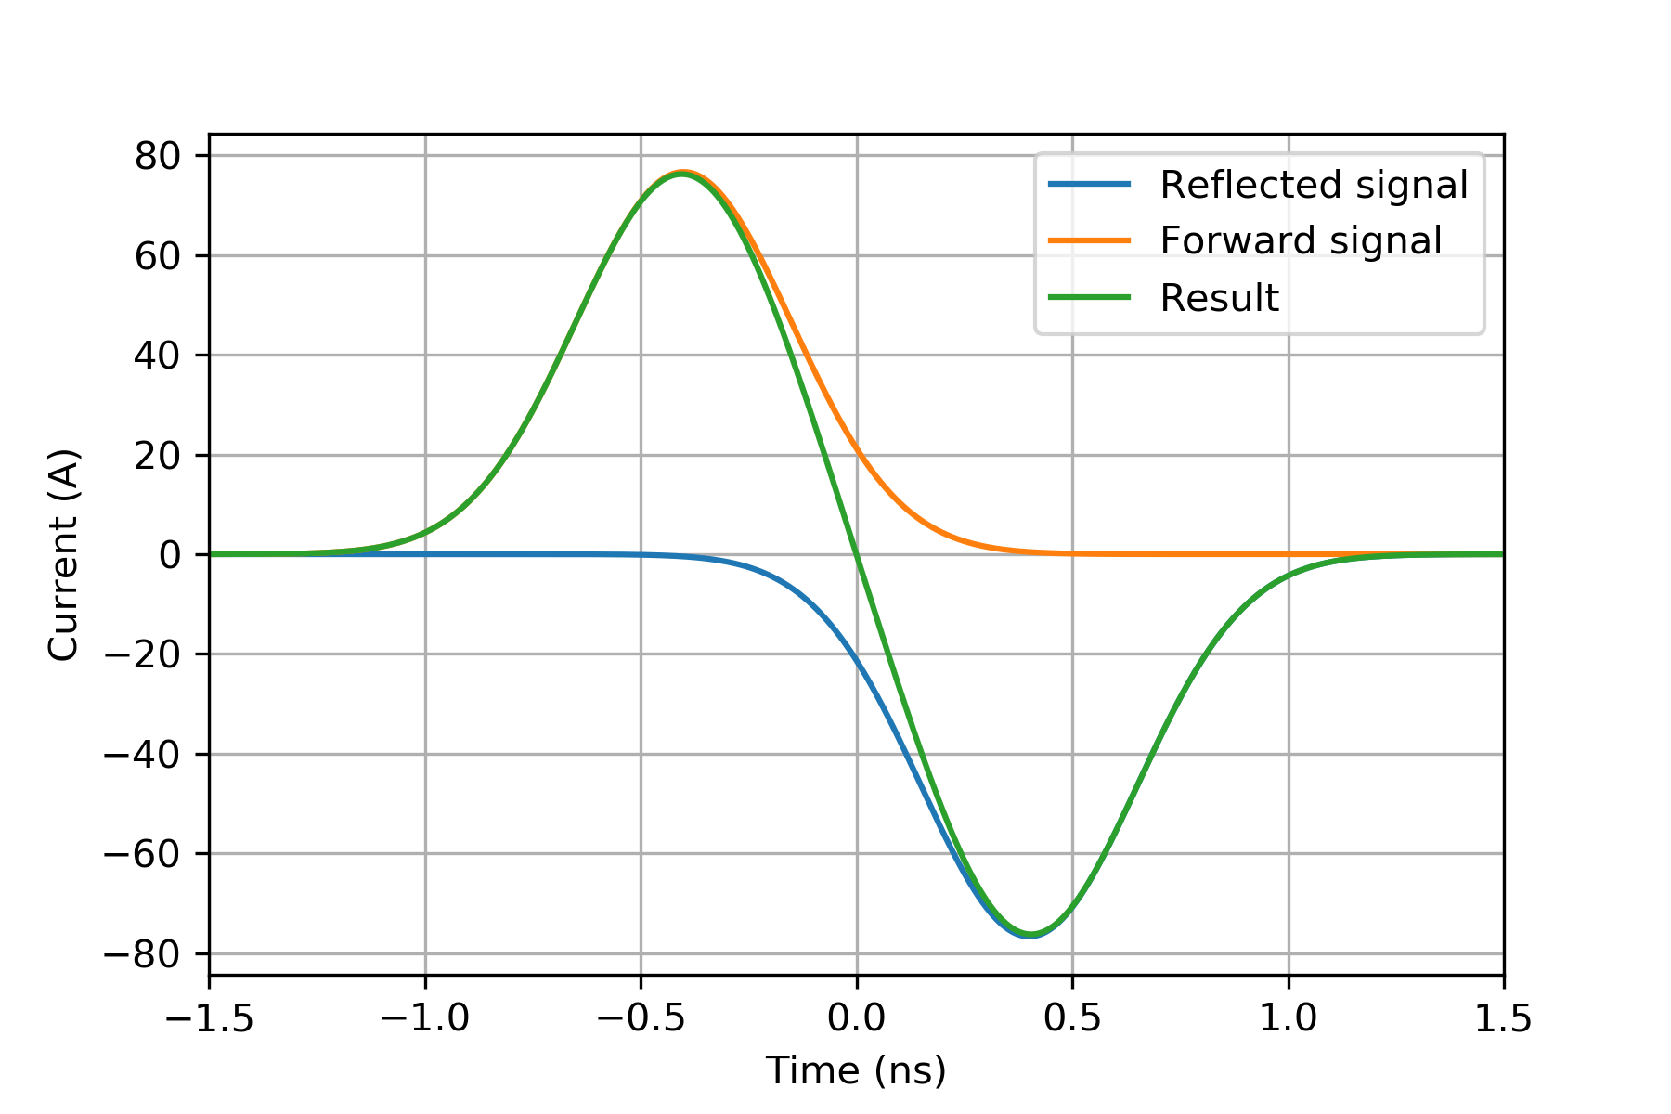
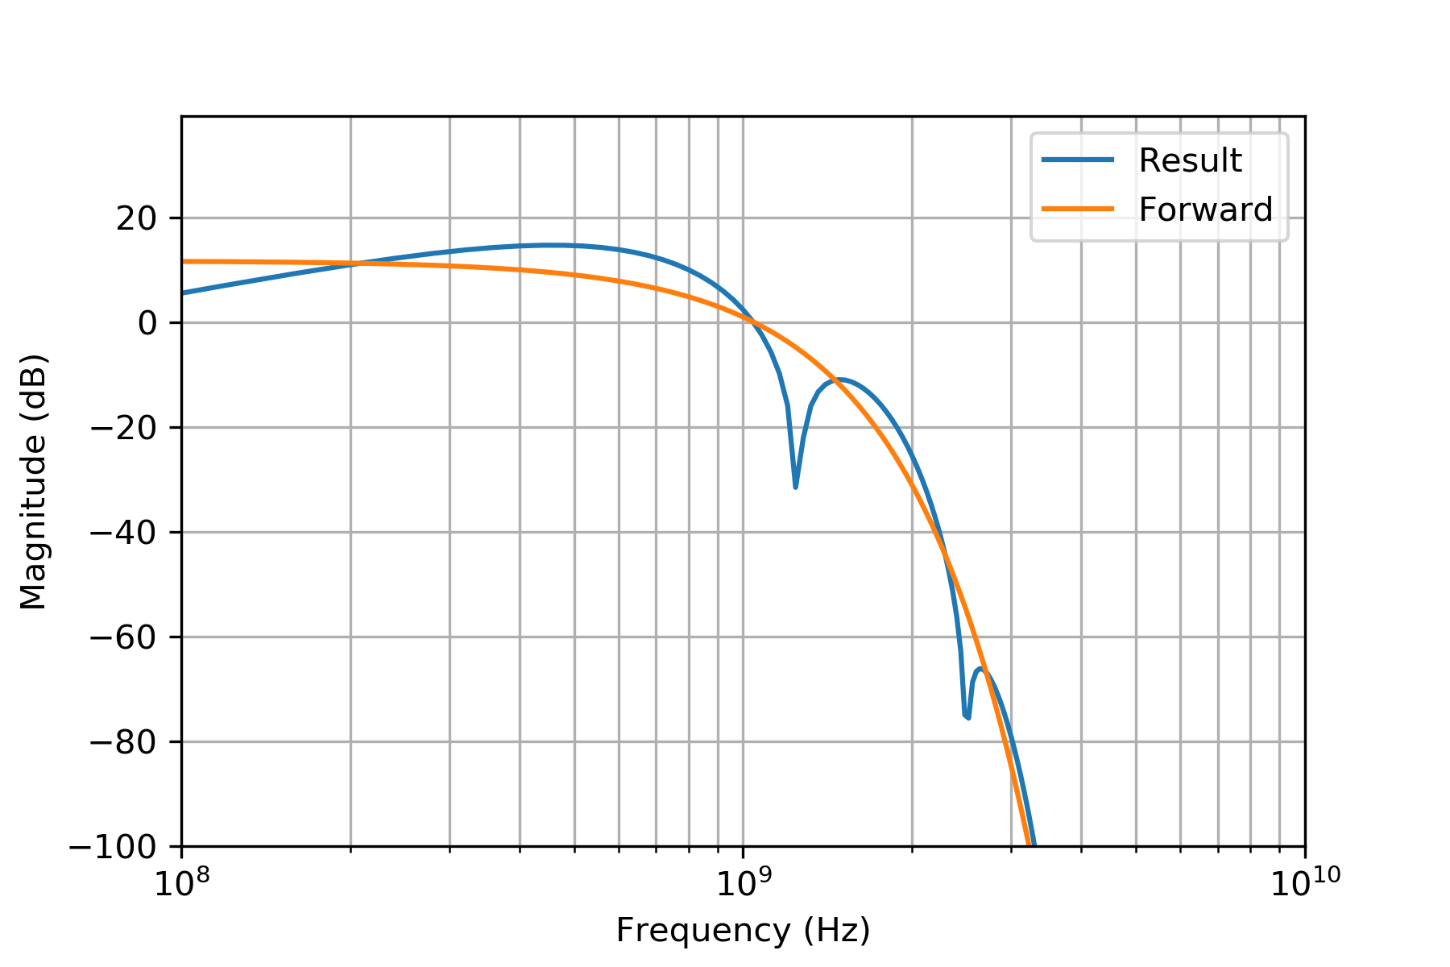
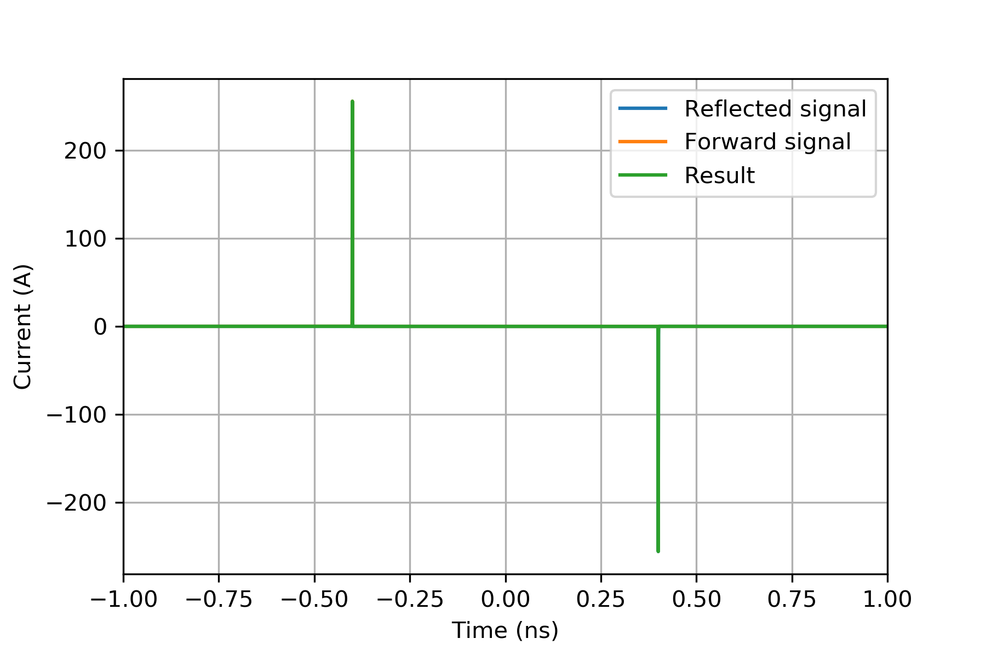
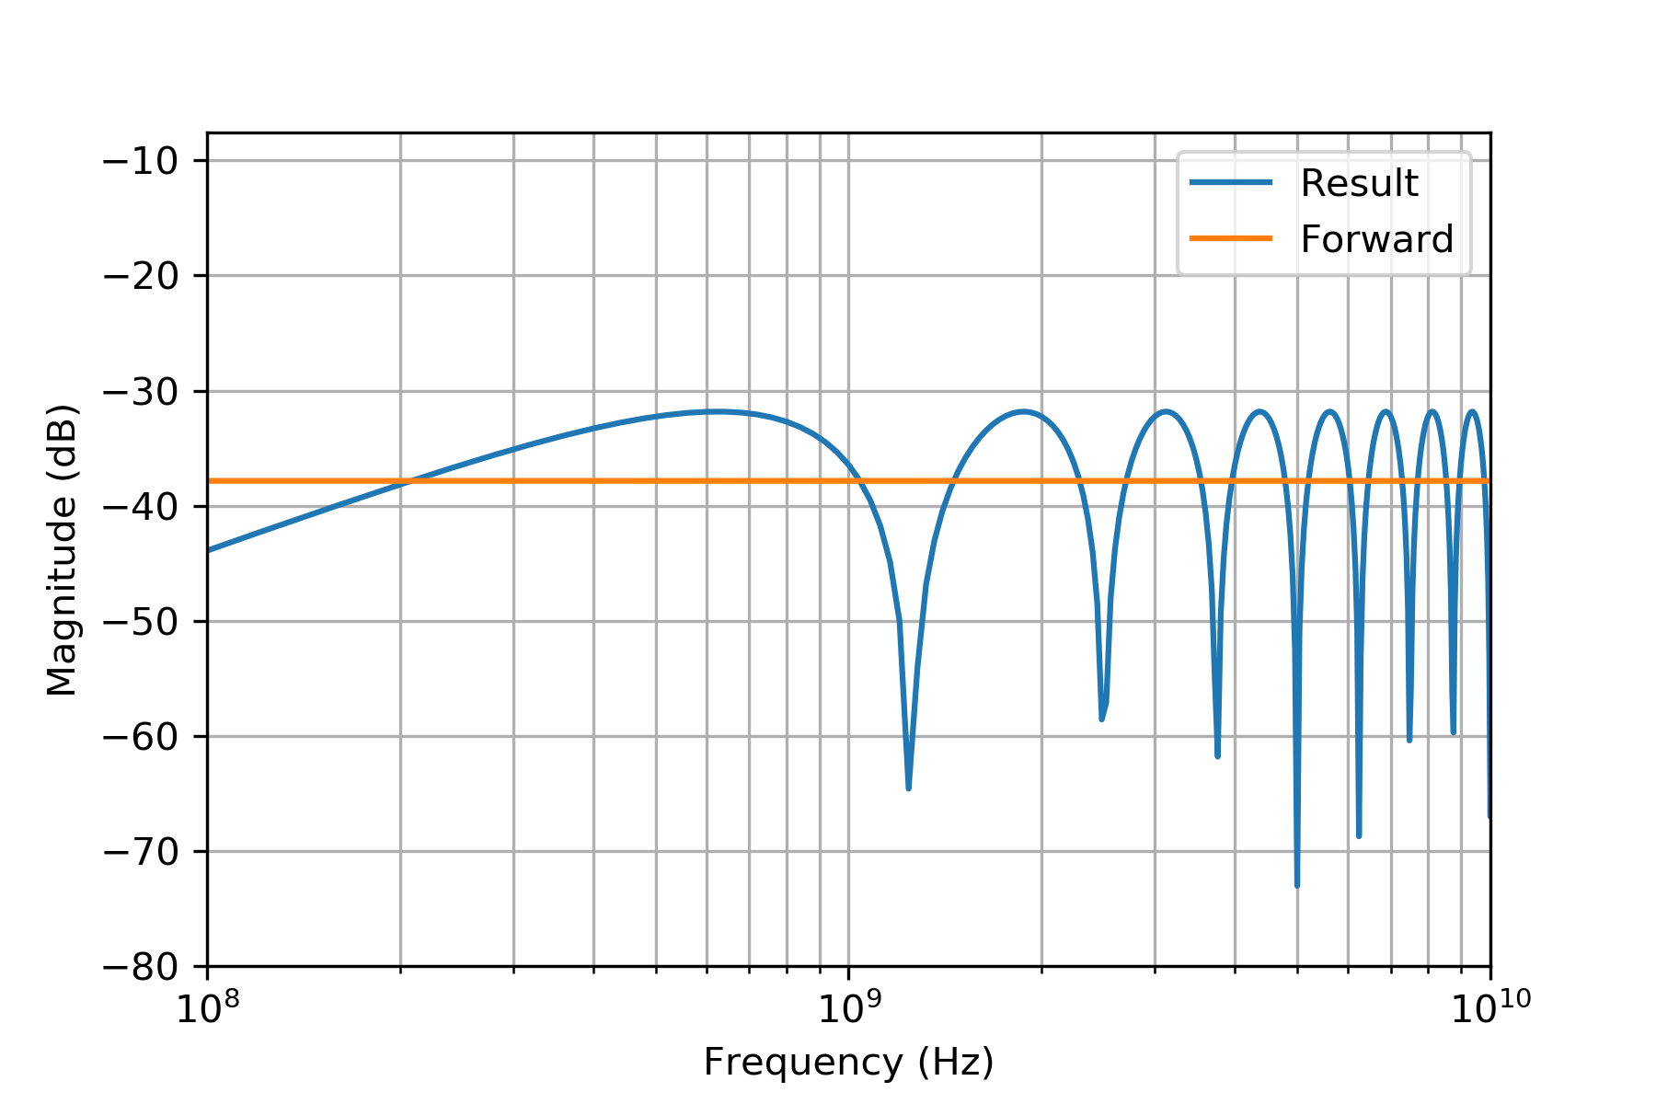
Ideal stripline pickup response
p⁺-like beam: 3e11 ppb
1 ns (4σ length)
e⁻-like beam: 1e9 ppb
4 ps (4σ length)

Slide 13
The real world

Slide 14
eBPM measurements
Two plates of BPM51 were disconnected from the electronics and connected to a Lecroy SDA18000 oscilloscope.
The signals were attenuated to protect the scope from the proton signal
All the measurement are single shot (no averaging)
The measurements results are presented for discussions. Drawing final conclusions requires a more broad work, including simulations.
 | Single channel | Dual channel (CH1 – CH2)
Bandwidth | 18 GHz | 12 GHz – 6 GHz
Sampling rate | 60 MSa/s | 40 MSa/s – 20 Msa/s
Resolution | 8 bits | 8 bits

Slide 15
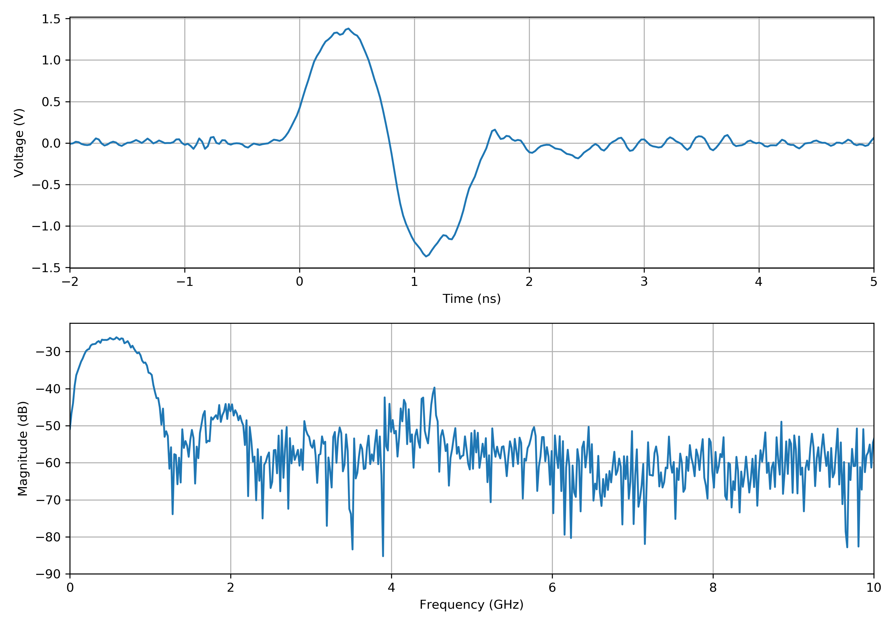
Proton beam measurements
Proton beam:
2e11 ppb
1 ns bunch length (4σ)
Most of the signal below the GHz

Slide 16
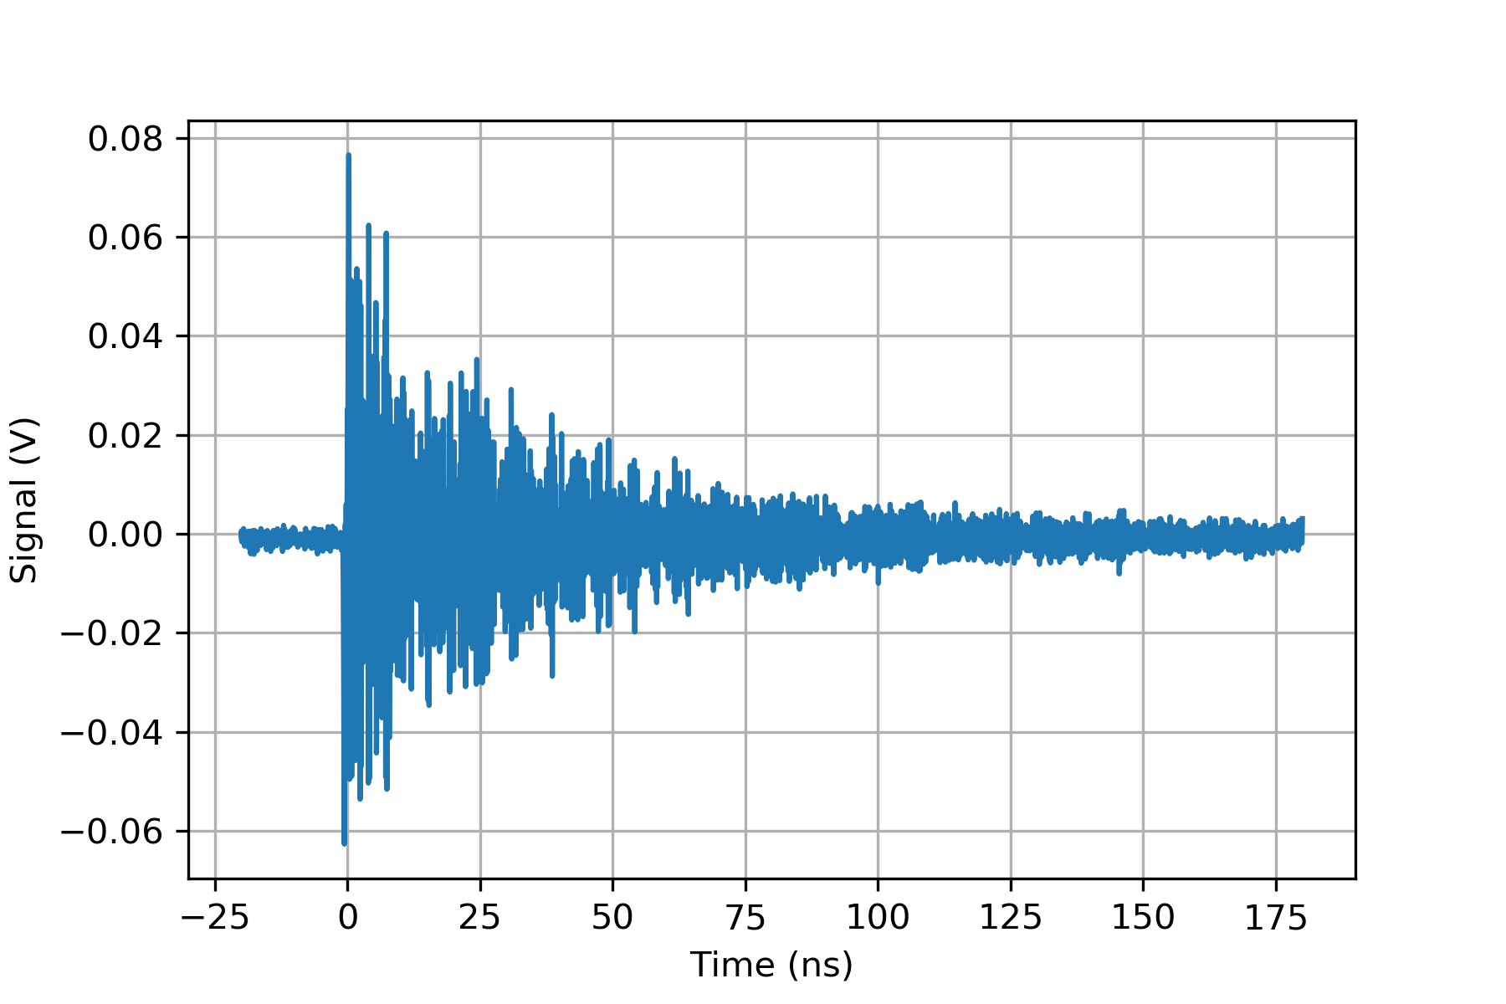
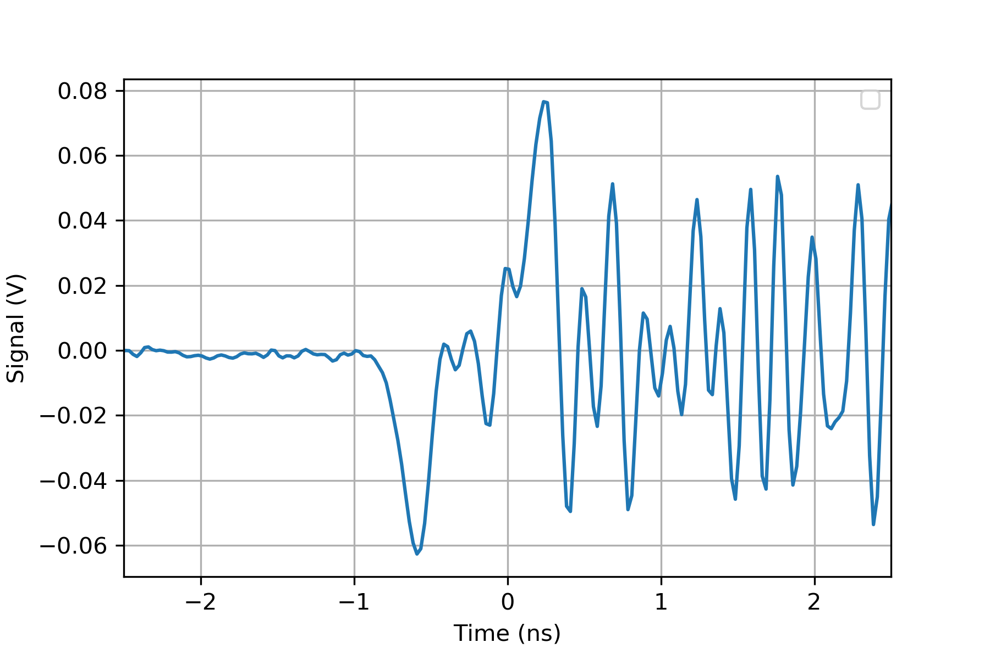
Electron beam measurements
Nominal electron beam:
600 pC bunch charge
4-6 ps bunch length (4σ)
The signal is visible, but followed by a resonance around 4-5 GHz

Slide 17
Electron beam measurements
Nominal electron beam:
600 pC bunch charge
4-6 ps bunch length (4σ)
The signal is visible, but followed by a resonance around 4-5 GHz
Electron bunch signal
Resonance pattern

Slide 18
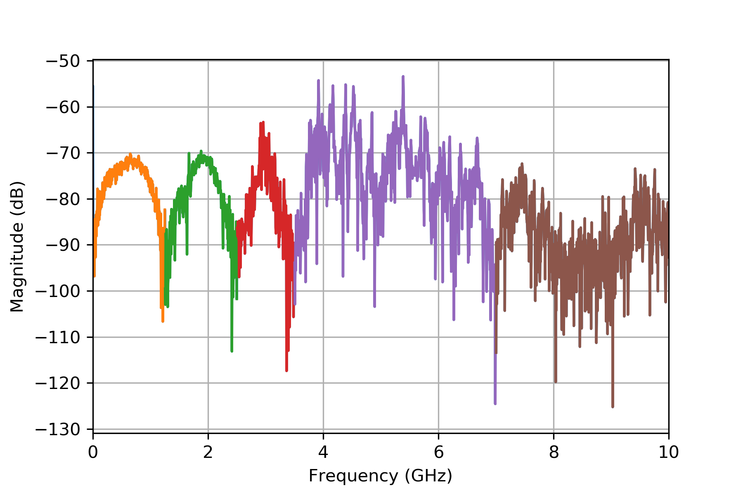
Electron beam measurements
Nominal electron beam:
As the beam component is constant up to 10s of GHz, the signal can be observed on the longer scale including the reflections
The dips in the spectrum are compatible with the pickup length
Three frequency intervals look interesting
0 – 1.25 GHz
1.25 – 2.5 GHz
2.5 – 3.5 GHz
Above 3.5 GHz mostly noise

Slide 19
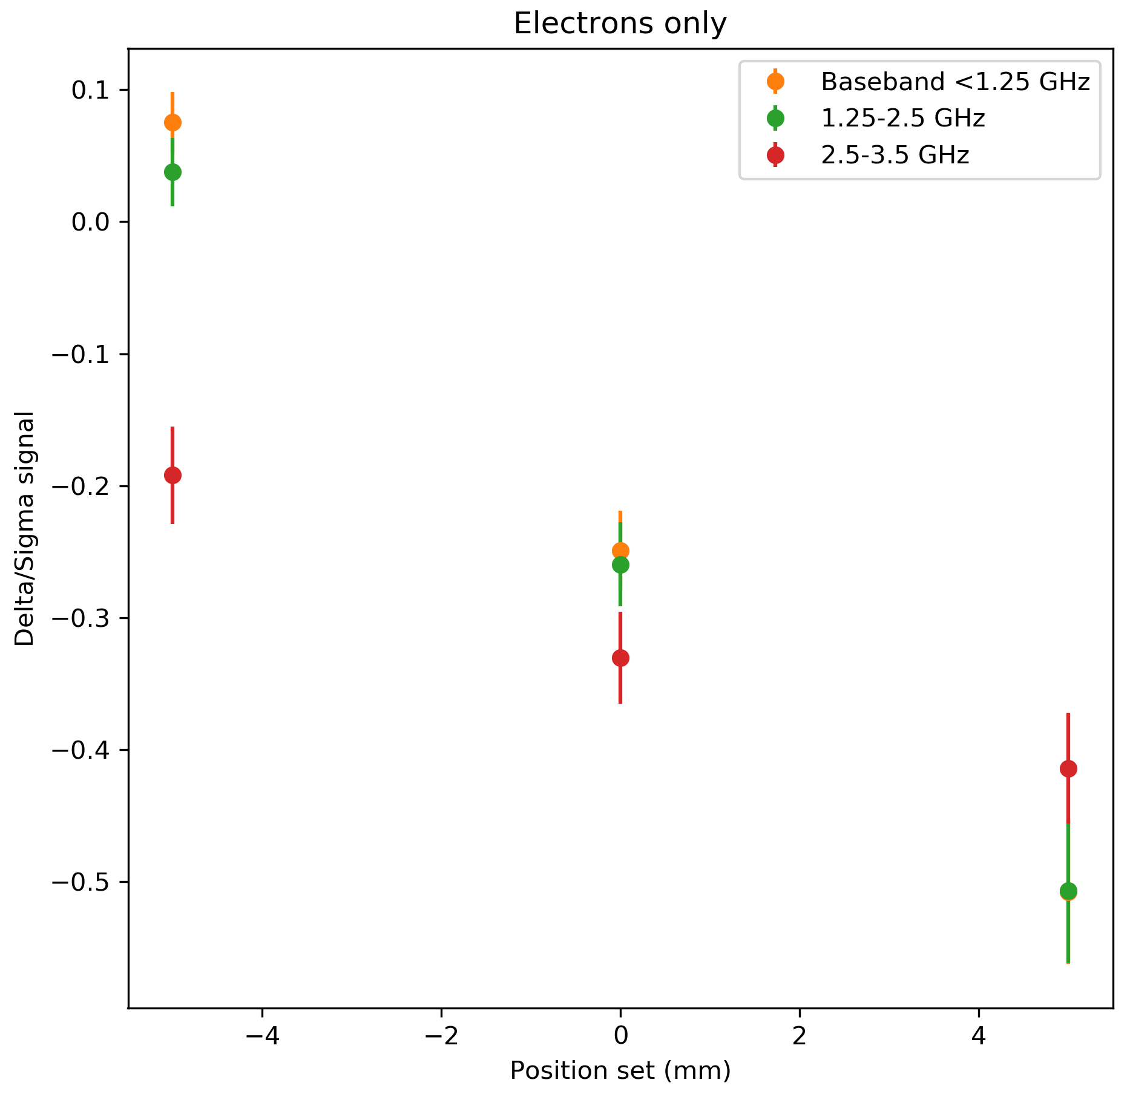
Electron beam measurements
Electron beam steering:
The electron beam was steered via YASP in the +/- 5 mm range
The first two frequency regions show clear dependency on the position of the Δ/Σ signal. The third one in a reduced scale.
Above the 3.5 GHz the position information is lost

Slide 20
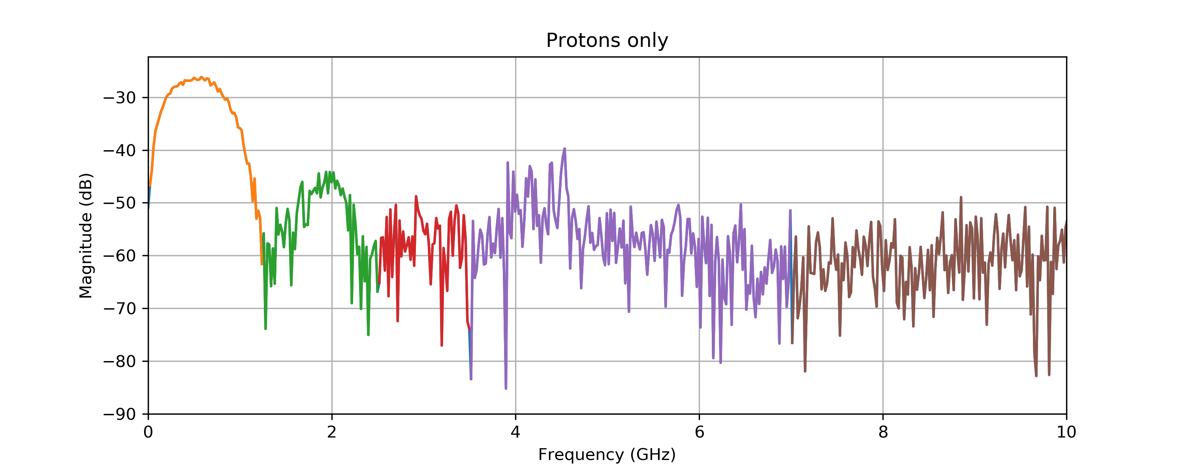
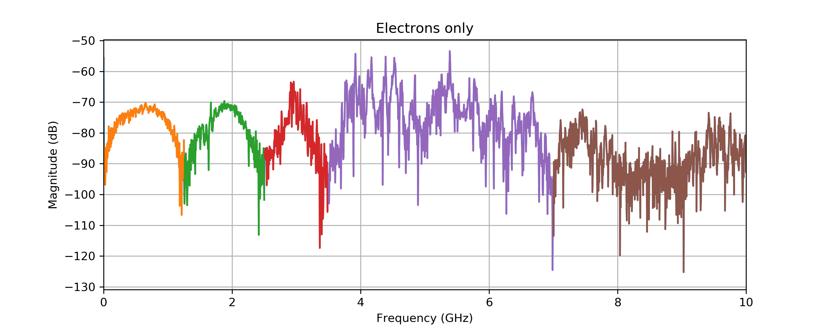
e⁻-p⁺ spectra comparison
Notes:
Cut at 10 GHz
Check if the data of the protons are ok or is it reduced sampling

Slide 21
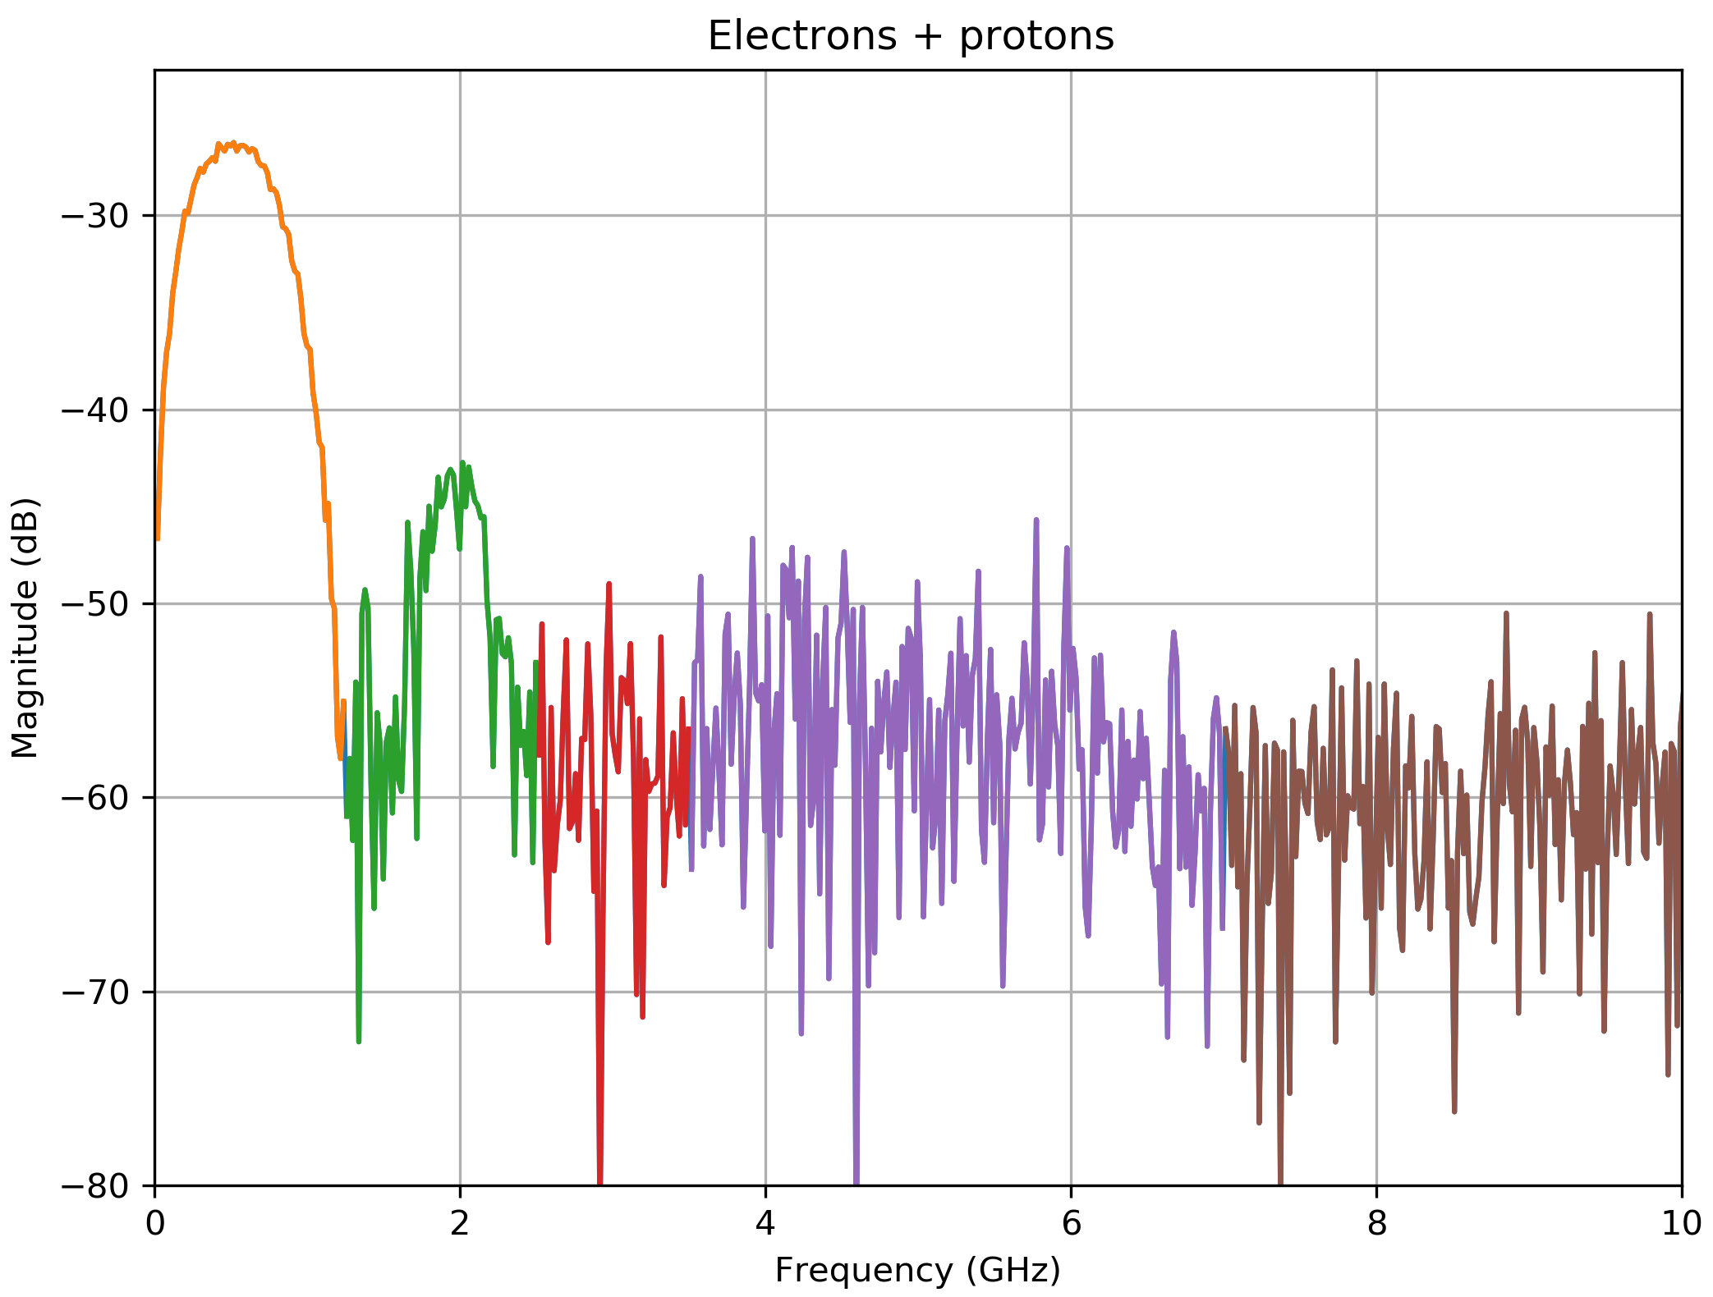
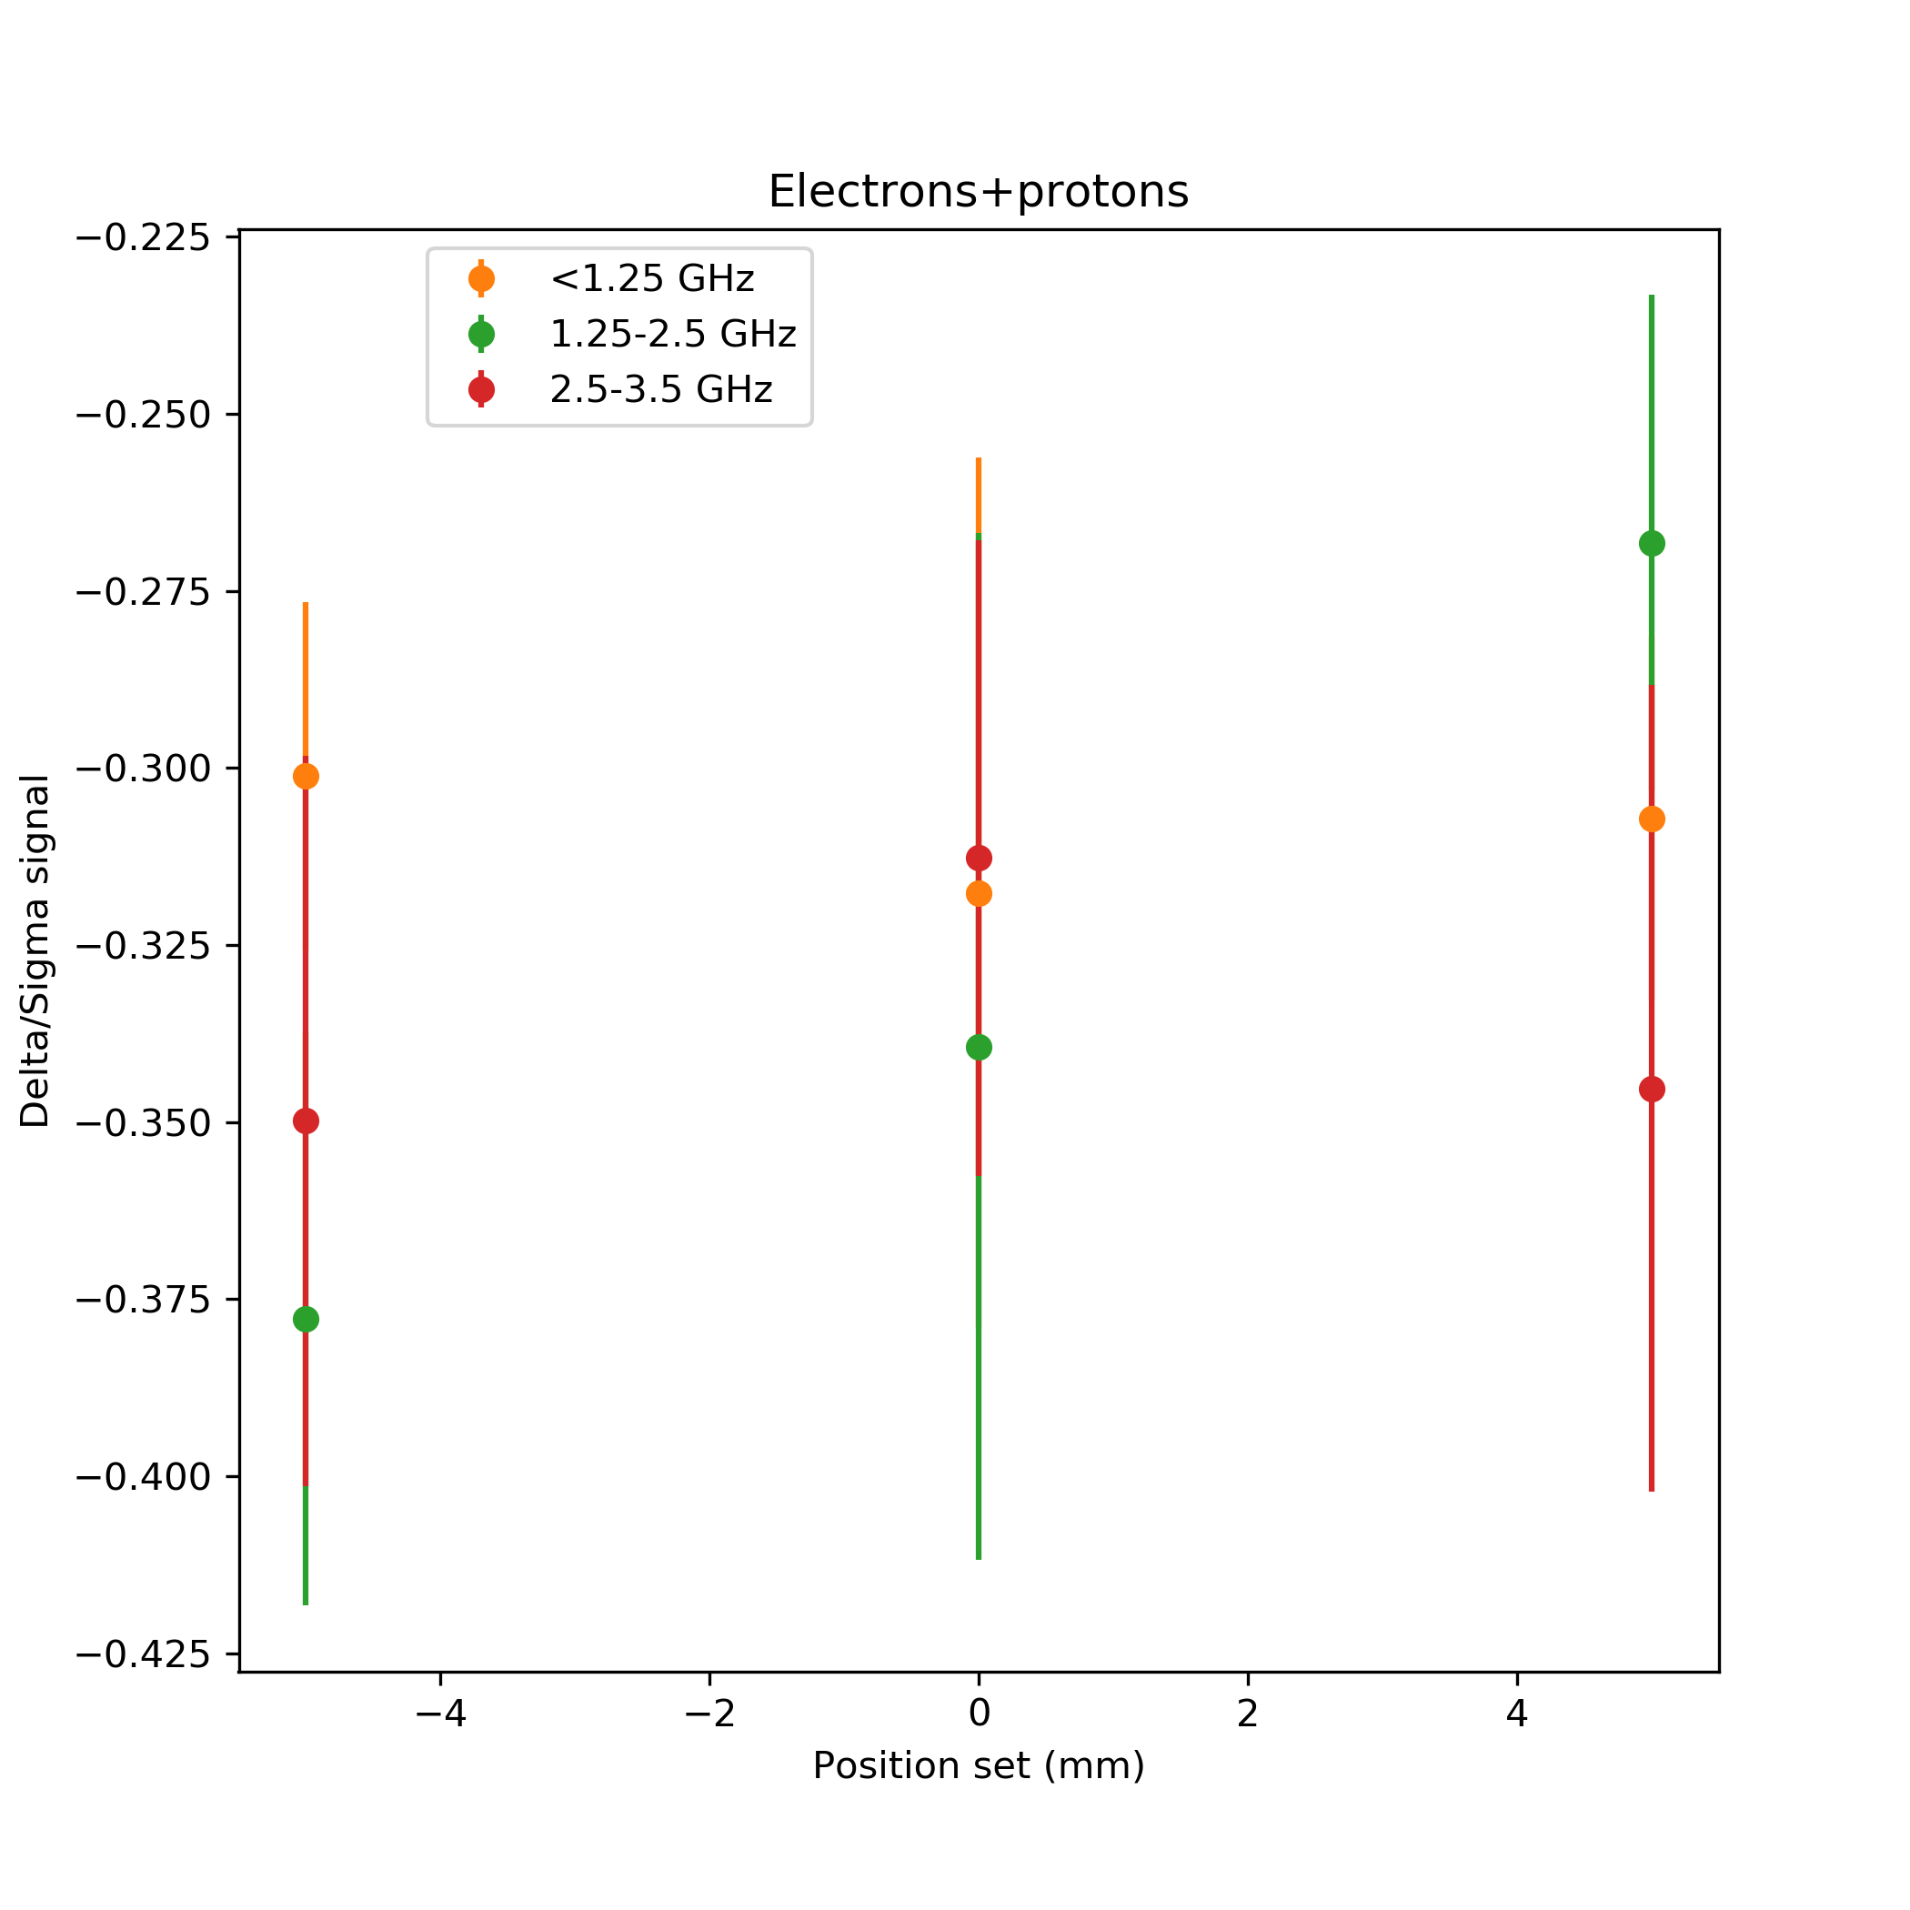
e⁻ and p⁺ together
Electron beam steering with proton presence:
The electron beam was steered via YASP in the +/- 5 mm range
Proton beam stayed in the centre due to the reduced time
In the orange region the signal of the protons dominates
Some dependence in the green band
Measurement limited by the dynamic range of the scope

Slide 22
Conclusions
The measurement of the electron beam position in presence of the protons is challenging
It might be possible if the beams are different in bunch charge and length
The bigger the difference the smaller the bias of the protons on the measured electron position
The bunch shape plays an important role as it changes the relative contribution of the two beams to the measurement
According to the measurements, the present system might be capable to measure the electron position in one of the higher frequency intervals before the noise
The measurement in presence of protons is limited by the dynamic range of the oscilloscope
The input of AWAKE on the future beams parameters in run 2 is fundamental to design reliable diagnostic

Slide 23
Future steps
EM simulation of the pickup structure in order to possibly understand the source of the resonance at high frequency
VNA measurements on a spare
Brainstorm on further future design ideas
Repeat the measurements using the new scope featuring 12 bits resolution. Only the electrons will be available, but the higher frequency bands will be accessible using the new instrument.

